Slide 1

مبانی داده کاوی
الگوهای پر تکرار و قوانین انجمنی
بهشیـد بهکمـال
نیمسال اول 1400-1399

Slide 2
Outline
Basic Concepts
Frequent Itemset Mining Methods
Which Patterns Are Interesting
Summary

Slide 3
What Is Frequent Pattern Analysis?
Frequent pattern: a pattern (a set of items, subsequences, substructures, etc.) that occurs frequently in a data set
First proposed by Agrawal, Imielinski, and Swami [1993] in the context of frequent itemsets and association rule mining
Motivation: Finding inherent regularities in data
What products were often purchased together?— Beer and diapers?!
What are the subsequent purchases after buying a PC?
What kinds of DNA are sensitive to this new drug?
Applications
Basket data analysis, cross-marketing, catalog design, sale campaign analysis, Web log (click stream) analysis, and DNA sequence analysis.

Slide 4
Basket data analysis

Slide 5
Basic concepts
Dataset: I = {I1, I2, … Im}
Transaction set: D = {T1, T2, …, Tn}
k-itemset: X = {x₁, …, x_{k}} , e.g. 2-itemset= {I1,I5}

Slide 6
Basic concepts …
support count (or absolute support) of X: Frequency or occurrence of an itemset X
(relative) support, s, is the fraction of transactions that contains X (i.e., the probability that a transaction contains X)
An itemset X is frequent if X’s support >= minsup threshold
Tid | Items bought
10 | Coke, Nuts, Diaper
20 | Coke, Coffee, Diaper
30 | Coke, Diaper, Eggs
40 | Nuts, Eggs, Milk
50 | Nuts, Coffee, Diaper, Eggs, Milk
support count {Nuts, Diaper} = 2
relative support {Nuts, Diaper} = 40%
Minsup=2 → {Nuts, Diaper} is frequent

Slide 7
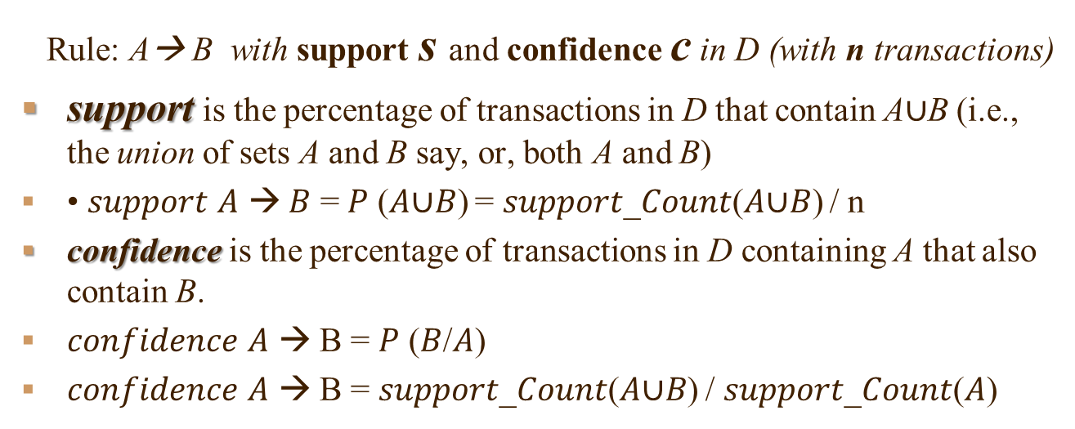
Support and Confidence
Rule: A→ B with support s and confidence c in D (with n transactions)
support is the percentage of transactions in D that contain A$∪$B (i.e., the union of sets A and B say, or, both A and B)
• 𝑠𝑢𝑝𝑝𝑜𝑟𝑡 𝐴 → 𝐵 = 𝑃 (𝐴∪𝐵) = 𝑠𝑢𝑝𝑝𝑜𝑟𝑡_𝐶𝑜𝑢𝑛𝑡(𝐴∪𝐵) / n
confidence is the percentage of transactions in D containing A that also contain B.
𝑐𝑜𝑛𝑓𝑖𝑑𝑒𝑛𝑐𝑒 𝐴 → B = 𝑃 (𝐵/𝐴)
𝑐𝑜𝑛𝑓𝑖𝑑𝑒𝑛𝑐𝑒 𝐴 → B = 𝑠𝑢𝑝𝑝𝑜𝑟𝑡_𝐶𝑜𝑢𝑛𝑡(𝐴∪𝐵) / 𝑠𝑢𝑝𝑝𝑜𝑟𝑡_𝐶𝑜𝑢𝑛𝑡(𝐴)
Customer
buys both
Customer
buys diaper
Customer
buys nuts

Slide 8
Association rule mining steps
1. Find all frequent itemsets:
each of these itemsets will occur equal or more than minimum support.
2. Generate strong association rules from the frequent itemsets:
rules must satisfy minimum support and minimum confidence

Slide 9
Association Rules
Find all the rules X → Y with minimum support and confidence
Example: Let minsup = 50%, minconf = 50%
Freq. Pat.: {Beer}:3, {Nuts}:3, {Diaper}:4, {Eggs}:3, {Beer, Diaper}:3
Tid
Items bought
10
Beer, Nuts, Diaper
Association rules: (many more!)
Beer → Diaper (60%, 100%)
Diaper → Beer (60%, 75%)
20
Beer, Coffee, Diaper
30
Beer, Diaper, Eggs
40
Nuts, Eggs, Milk
50
Nuts, Coffee, Diaper, Eggs, Milk

Slide 10
A problem
A long pattern contains a combinatorial number of sub-patterns:
- {a₁, …, a₁₀₀} Contains 1.27*10³⁰ sub-patterns!

Slide 11
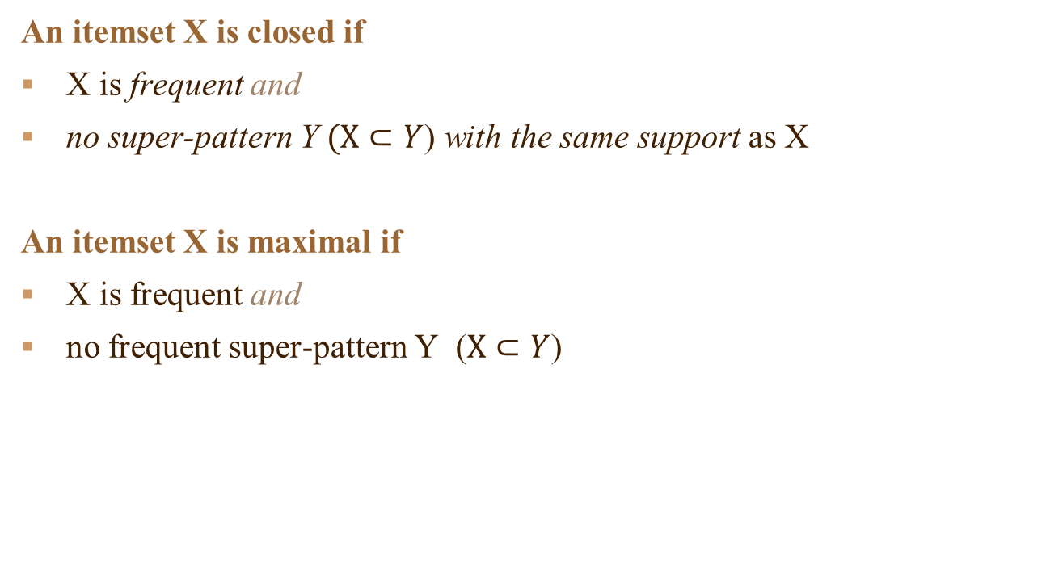
Closed and Maximal Frequent Itemset
An itemset X is closed if
X is frequent and
no super-pattern Y $(X⊂Y$) with the same support as X
An itemset X is maximal if
X is frequent and
no frequent super-pattern Y ($X⊂Y$)

Slide 12
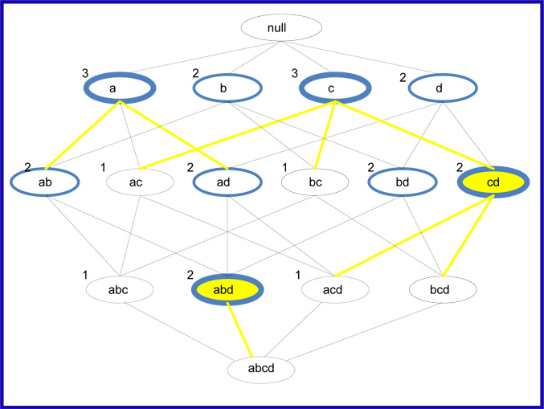
Example: maximal, closed and frequent itemsets
Min support:2
frequent itemsets: blue circle
closed frequent itemsets: thick blue circle
maximal frequent itemsets: yellow fill

Slide 13
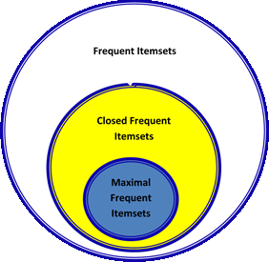
Relationship between Frequent Itemset Representations

Slide 14
Frequent Itemset Mining Methods

Slide 15
Scalable Frequent Itemset Mining Methods
Apriori: A Candidate Generation-and-Test Approach
1994: Apriori (Agrawal & Srikant@VLDB’94)
FPGrowth: A Frequent Pattern-Growth Approach
2000: Freq. pattern growth (FPgrowth—Han, Pei & Yin@SIGMOD’00)
ECLAT: Frequent Pattern Mining with Vertical Data Format
2002: Vertical data format approach (Charm—Zaki & Hsiao@SDM’02)

Slide 16
The Downward Closure Property
The downward closure property of frequent patterns
Any subset of a frequent itemset must be frequent
If {beer, diaper, nuts} is frequent, so is {beer, diaper}
i.e., every transaction having {beer, diaper, nuts} also contains {beer, diaper}
The idea of Apripri:
If there is any itemset which is infrequent, its superset should not be generated/tested!

Slide 17
Apriori: A Candidate Generation & Test Approach
Apriori pruning principle: If there is any itemset which is infrequent, its superset should not be generated/tested!
Method:
Initially, scan DB once to get frequent 1-itemset
Generate length (k+1) candidate itemsets from length k frequent itemsets
Test the candidates against DB
Terminate when no frequent or candidate set can be generated

Slide 18
The Apriori Algorithm—An Example
Sup_{min} = 2
Itemset | sup
{A} | 2
{B} | 3
{C} | 3
{D} | 1
{E} | 3
L₁
Itemset | sup
{A} | 2
{B} | 3
{C} | 3
{E} | 3
C₁
Tid | Items
10 | A, C, D
20 | B, C, E
30 | A, B, C, E
40 | B, E
1st scan
C₂
C₂
Itemset | sup
{A, B} | 1
{A, C} | 2
{A, E} | 1
{B, C} | 2
{B, E} | 3
{C, E} | 2
Itemset
{A, B}
{A, C}
{A, E}
{B, C}
{B, E}
{C, E}
L₂
Itemset | sup
{A, C} | 2
{B, C} | 2
{B, E} | 3
{C, E} | 2
2nd scan
C₃
Itemset
{B, C, E}
3rd scan
L₃
Itemset | sup
{B, C, E} | 2

Slide 19
The Apriori Algorithm (Pseudo-Code)
C_{k}: Candidate itemset of size k
L_{k} : frequent itemset of size k
L₁ = {frequent items};
for (k = 1; L_{k} !=∅; k++) do begin
C_{k+1} = candidates generated from L_{k};
for each transaction t in database do
increment the count of all candidates in C_{k+1} that are contained in t
L_{k+1} = candidates in C_{k+1} with min_support
end
return ∪_{k} L_{k};

Slide 20
Implementation of Apriori
How to generate candidates?
Step 1: self-joining L_{k}
Step 2: pruning
Example of Candidate-generation
L₃={abc, abd, acd, ace, bcd}
Self-joining: L₃*L₃
abcd from abc and abd
acde from acd and ace
Pruning:
acde is removed because ade is not in L₃
C₄ = {abcd}

Slide 21
Example of Apriori

Slide 22
Example of Apriori …

Slide 23
Generating association rules
Resulting association rules from {I1, I2, I5}:
Rule 1:
Rule 2:
Rule 3:
Rule 4:
Rule 5:
Rule 6:
Min Confidence threshold: 70% → Strong rules are 2, 3, 6

Slide 24
Further Improvement of the Apriori Method
Major computational challenges
Multiple scans of transaction database
Huge number of candidates
Tedious workload of support counting for candidates
Improving Apriori: general ideas
Reduce passes of transaction database scans
Reduce the number of candidates
Facilitate support counting of candidates

Slide 25
Improvement of the Apriori Method
Hash-based
Transaction Reduction
Partitioning
Sampling
Dynamic itemset counting

Slide 26
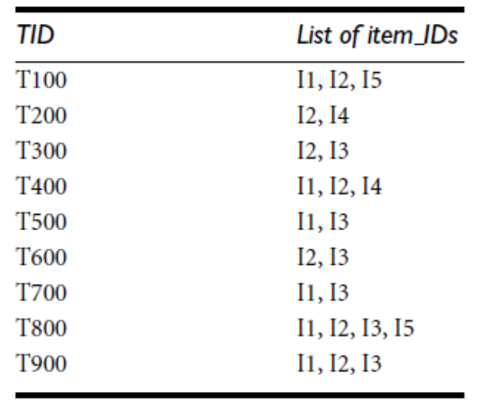
1. Hash based
Idea: Reduce the size of the candidate k-itemsets
Min support = 3

Slide 27
2. Transaction reduction
Idea: Reduce the number of transactions scanned in future iterations
Method:
A transaction that does not contain any frequent k-itemsets cannot contain any frequent (k+1) itemsets.
Such a transaction can be removed from further consideration

Slide 28
3. Partitioning
Idea: Reduce the number of scanned
Tow step scan
Any itemset that is potentially frequent in DB must be frequent in at least one of the partitions of DB
Scan 1: partition database and find local frequent patterns
DB₁
+
DB₂
+
+
DB_{k}
= DB
sup₁(i) < σDB₁
sup₂(i) < σDB₂
sup_{k}(i) < σDB_{k}
sup(i) < σDB

Slide 29
3. Partitioning …
Scan 2: consolidate global frequent patterns

Slide 30
4. Sampling for Frequent Patterns
Idea: reduce the number of scans
Select a sample of original database, mine frequent patterns within sample using Apriori
Scan database once to verify frequent itemsets found in sample, only borders of closure of frequent patterns are checked
Example: check abcd instead of ab, ac, …, etc.
Scan database again to find missed frequent patterns

Slide 31
5. Dynamic Itemset Counting (DIC)
ABCD
Idea: Reduce number of scans
Once both A and D are determined frequent, the counting of AD begins
Once all length-2 subsets of BCD are determined frequent, the counting of BCD begins
ABC
ABD
ACD
BCD
AB
AC
BC
AD
BD
CD
Transactions
1-itemsets
A
B
C
D
Apriori
2-itemsets
…
{}
Itemset lattice
1-item
2-items
DIC
3-items

Slide 32
Frequent Pattern Mining with Vertical Data Format

Slide 33
Horizontal and Vertical Data Format
Horizontal data format:
Both the Apriori and FP-growth methods mine frequent patterns from a set of transactions in Transaction-itemset format
T100= {I1, I2, I5} , T200= {I2, I4}
Vertical data format:
ECLAT method mines frequent patterns from a set of items in Item-transactionset format
I2 = {T100, T200}
Eclat (Equivalence Class Transformation)
Ref: Eclat (Zaki et al. @KDD’97)

Slide 34
Vertical Data Format: process
Scan D once to transform the horizontally formatted data into the vertical format.
The support count of an itemset is the length of the TID set.
Starting with k=1, the frequent k-itemsets can be used to construct the candidate (k+1)-itemsets based on the Apriori property.
The computation is done by intersection of the TID sets of the frequent k-itemsets.
This process repeats, with k incremented by 1 each time, until no frequent itemsets or candidate itemsets can be found.

Slide 35


Vertical Data Format: example
$$∩$$
$$∩$$

Slide 36
Vertical Data Format
Advantages:
Apriori property in the generation of candidate
no need to scan the database to find the support of k+1
Disadvantages:
cost of registering long TID sets
costs of intersections
Solution: keeps track of only the differences of the TID sets, e.g. CHARM

Slide 37
Example
Number of Transactions: 10000
Transactions contain computers games: 6000
Transactions contain videos: 7500
Transactions contain both: 4000
𝑀𝑖𝑛 − sup = 30% 𝑀𝑖𝑛 − 𝑐𝑜𝑛𝑓 = 60%
𝐶𝑜𝑚𝑝𝑢𝑡𝑒𝑟 𝑔𝑎𝑚𝑒𝑠 → videos
𝑠𝑢𝑝𝑝𝑜𝑟𝑡 = 40%, 𝐶𝑜𝑛𝑓𝑖𝑑𝑒𝑛𝑐𝑒 = 66%
Misleading strong rule!

Slide 38
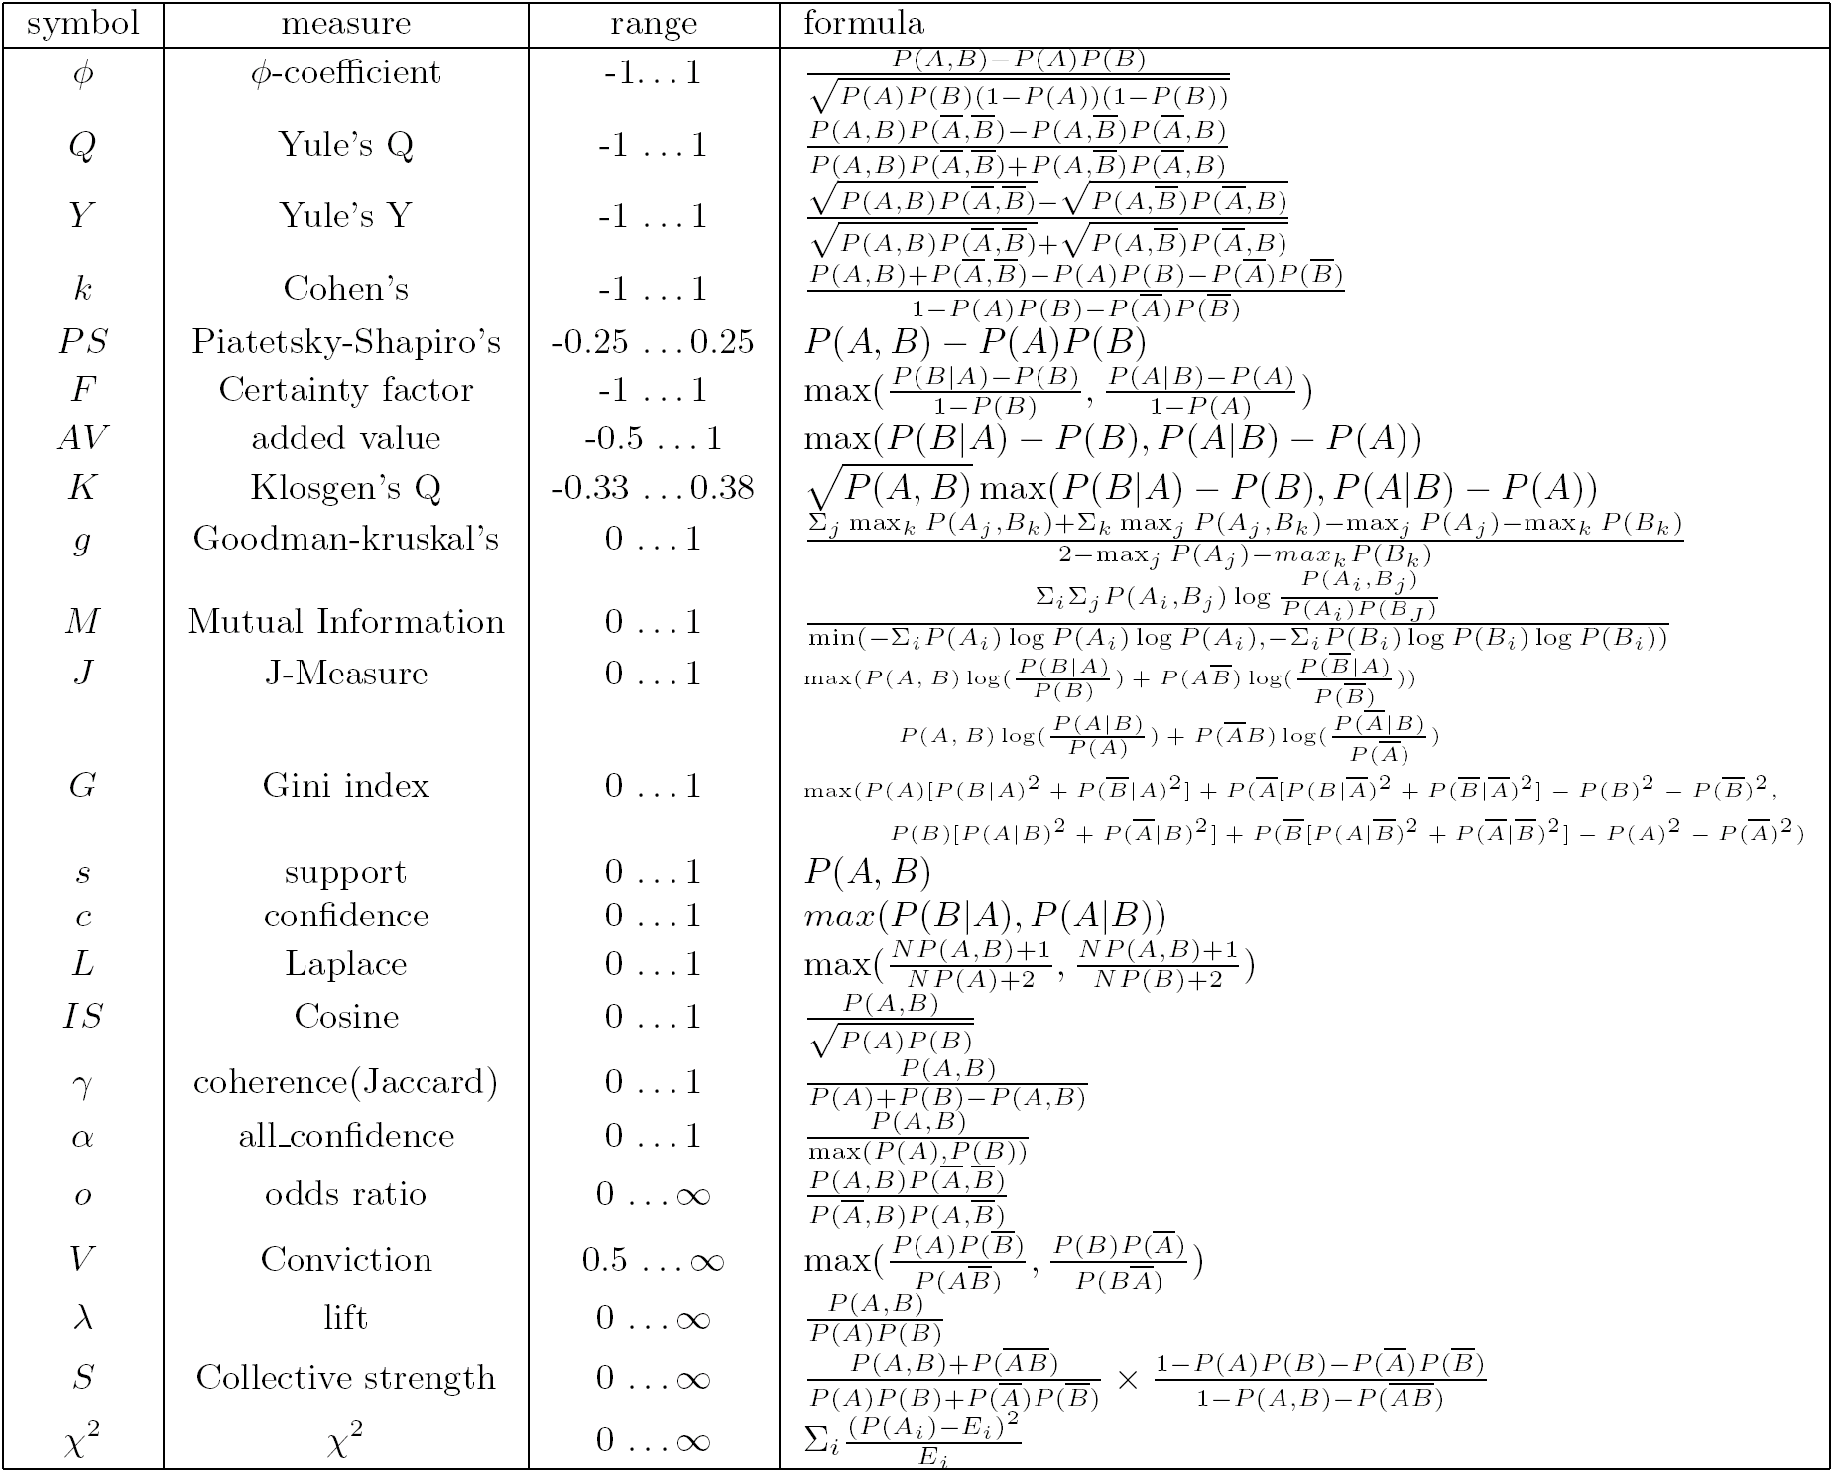
Well-known Measures

Slide 39
From association rule to correlation analysis
Correlation measure:
𝑙𝑖𝑓𝑡 𝐴, 𝐵 = 𝑃(𝐴∪𝐵) / 𝑃(𝐴) .𝑃(𝐵)
lift > 1 : Positive correlation
Lift< 1 : Negative correlation
Lift =1 : independency

Slide 40
FP-Growth: A Frequent Pattern-Growth Approach (برای مطالعه)

Slide 41
Frequent Pattern Growth (FP-Growth)
Idea: Mining Frequent Patterns Without Candidate Generation
Bottlenecks of the Apriori approach
Breadth-first (i.e., level-wise) search
Candidate generation and test
Often generates a huge number of candidates
The FPGrowth Approach
Depth-first search
Avoid explicit candidate generation

Slide 42
FP-growth: two step approach
Step 1: Build a compact data structure called the FP-tree
Built using 2 passes over the data-set.
Step 2: Extracts frequent itemsets directly from the FP-tree
The problem of mining frequent patterns in databases is transformed into that of mining the FP-tree.

Slide 43
FP-Growth method
Constructing FP-tree
Scan D and derives the set of frequent items (1-itemsets) and their support counts (frequencies).
Sort the frequent items in the order of descending support count in list L.
Create the root of the tree, labeled with “null.”
Scan database D a second time. The items in each transaction are processed in L order (descending support count).
For each transaction T, select and sort the frequent items according to the order of L. Let the sorted frequent item list in Trans be [pjP], where p is the first element and P is the remaining list.
Call insert tree ([pjP], T), which is performed as follows: If T has a child N such that N.item-name = p.item-name, then increment N’s count by 1; else create a new node N, and let its count be 1, its parent link be linked to T, and its node-link to the nodes with the same item-name via the node-link structure.

Slide 44
FP-Growth method
2. Mining FP-tree by calling FP_growth:

Slide 45
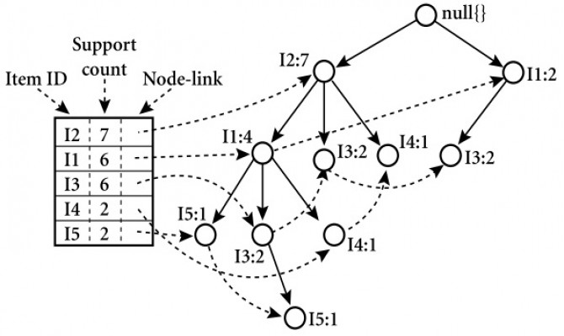
1. Constructing FP-tree

Slide 46
2. Mining FP-tree
Starting at the end nodes in the FP-tree
Traverse the FP-tree by following the link of each frequent item p
Accumulate all of transformed prefix paths of item p to form ’s conditional pattern base
Conditional (sub-)pattern base

Slide 47
FP-Growth Structure
Advantages
only 2 passes over data-set
“compresses” data-set
no candidate generation
Divide-and-conquer strategy
much faster than Apriori
Disadvantages
FP-Tree may not fit in memory!
FP-Tree is expensive to build
Solution: partition a database into a set of projected DBs. Then construct and mine FP-tree for each projected DB

Slide 48
Summary
Basic concepts
association rules, support and confident, closed and max-patterns
Scalable frequent pattern mining methods
Apriori (Candidate generation & test)
ECLAT (Vertical format approach)
FPgrowth (Projection-based)
Which patterns are interesting?
Pattern evaluation methods

Slide 49


